Slide 1
ITCS 3134
YIN HANG KWOK
E16 - Hough 2

Slide 2
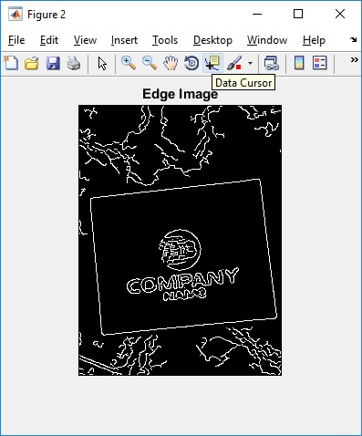
No non-max suppression edge image

Slide 3
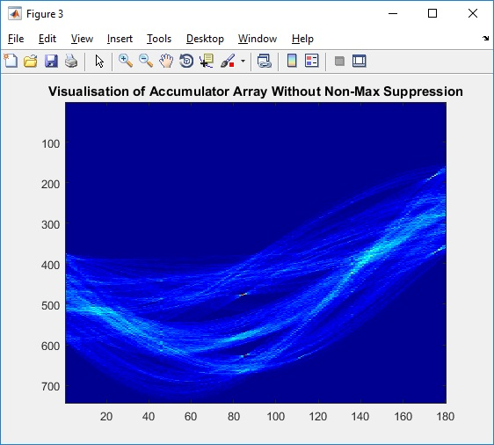
accumulator array

Slide 4
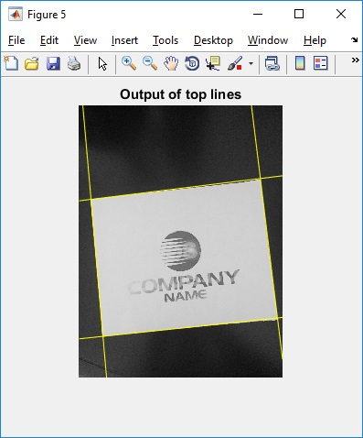
visualization of top 4 lines on the original color image

Slide 5
Non-max suppression that corresponds to deleting non-max within +/- 5 degrees (and pixels) edge image

Slide 6
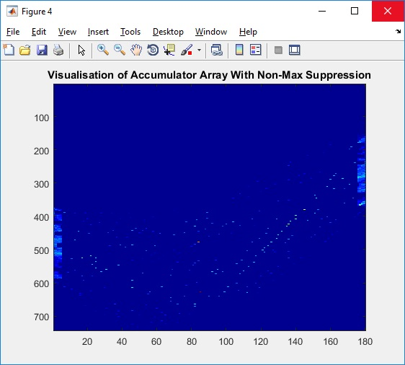
accumulator array

Slide 7
visualization of top 4 lines on the original color image

